Slide 1

Battle of neighborhoods
Akrash Sharma

Slide 2
Introduction
The global COVID-19 pandemic has affected several countries in the world with Canada being one of them too. Toronto which is the 4th most populous city in North America is vastly affected too.
The big question is which neighborhood should one choose in Toronto amidst this pandemic?
In this project, I will discuss different parameters to consider and use foursquare location data and clustering of venue information to determine a less impacted neighborhood in Toronto.

Slide 3
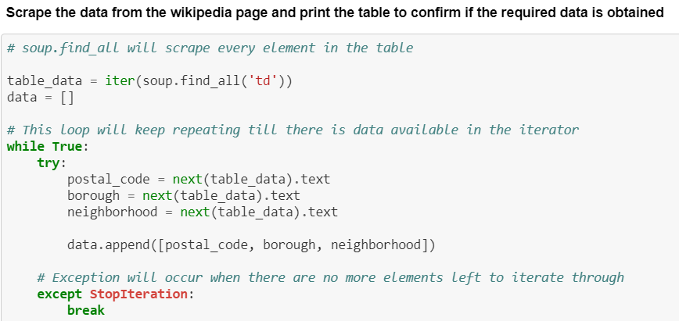
Data

Slide 4
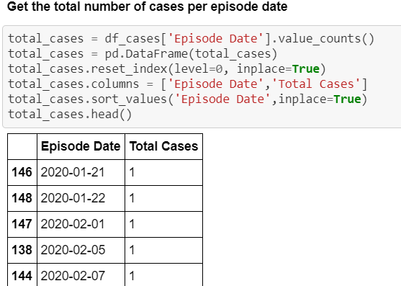
Methodology
The total number of cases per episode date was obtained.

Slide 5
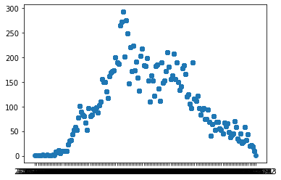
A scatter plot was obtained to analyze the relationship between total number of cases and the episode date.

Slide 6
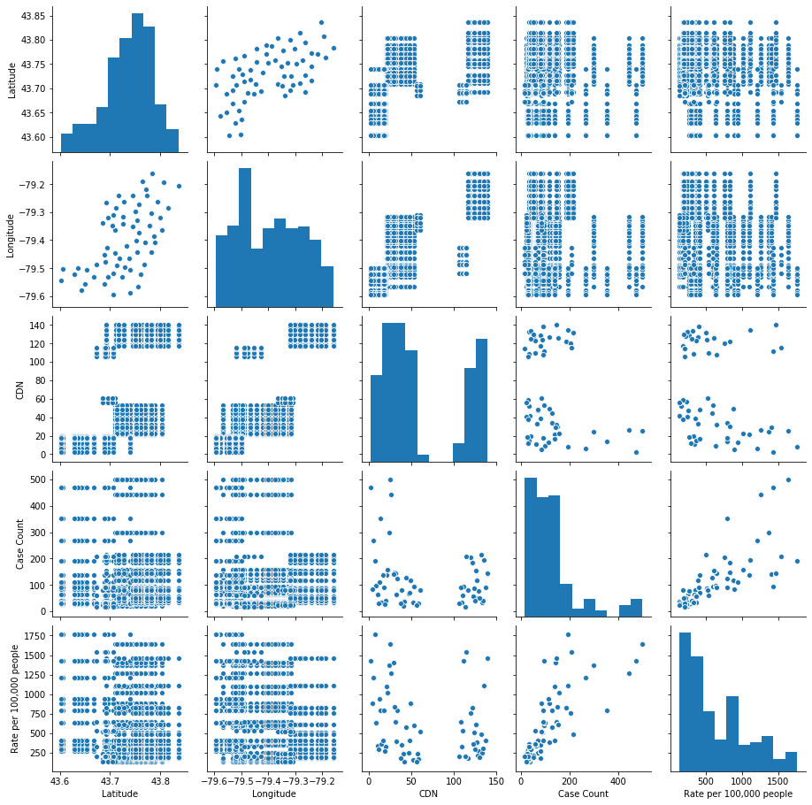
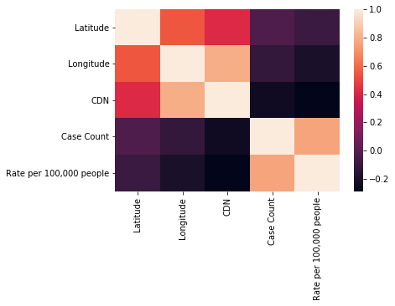
A heat map and a pairplot were made of all the factors to visually gauge average correlation of COVID-19 cases and factors in the dataset.

Slide 7
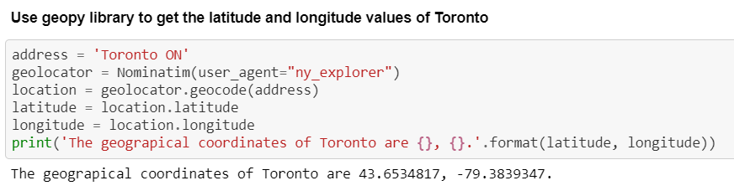
Google maps geocoder API was used to obtain the latitude and longitude values of the city of Toronto.

Slide 8
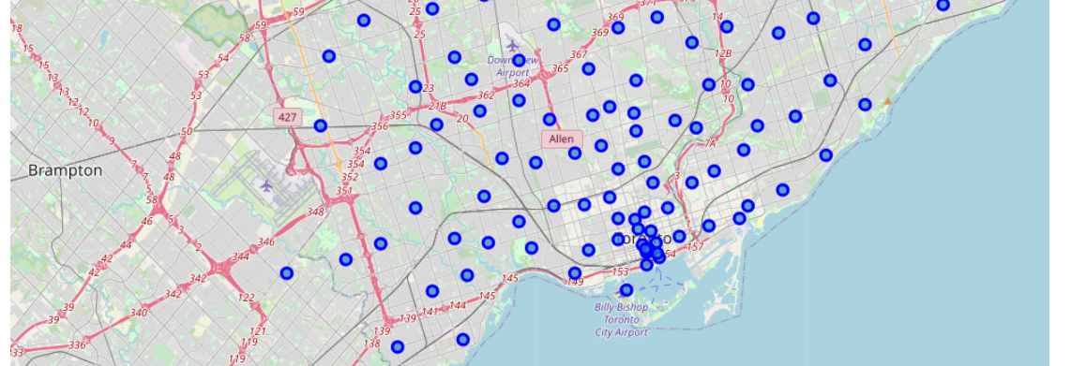
Folium was used to visualize the data in an interactive leaflet map. A map of the city of Toronto with the neighborhoods superimposed on it was created.

Slide 9
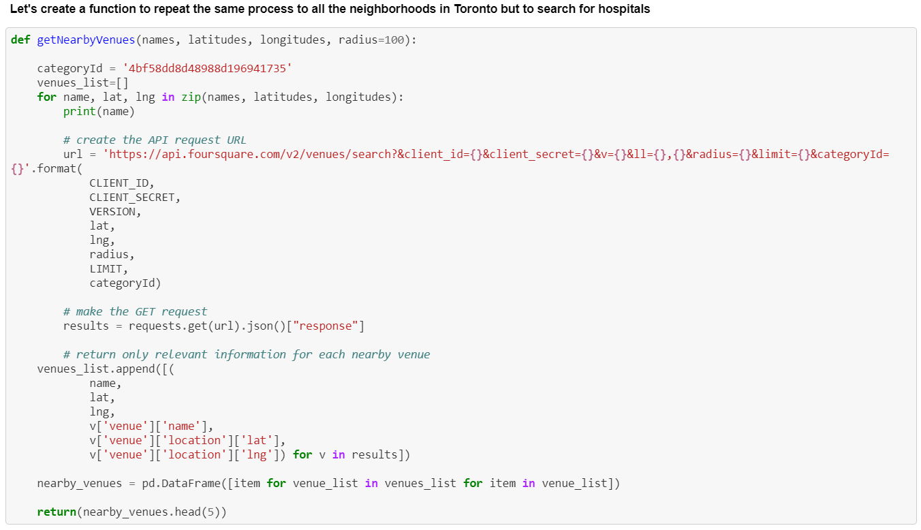
I utilized the Foursquare API to explore the boroughs and search for hospitals. I searched for hospitals around each borough in a 100 meter radius from their given latitude and longitude values.

Slide 10
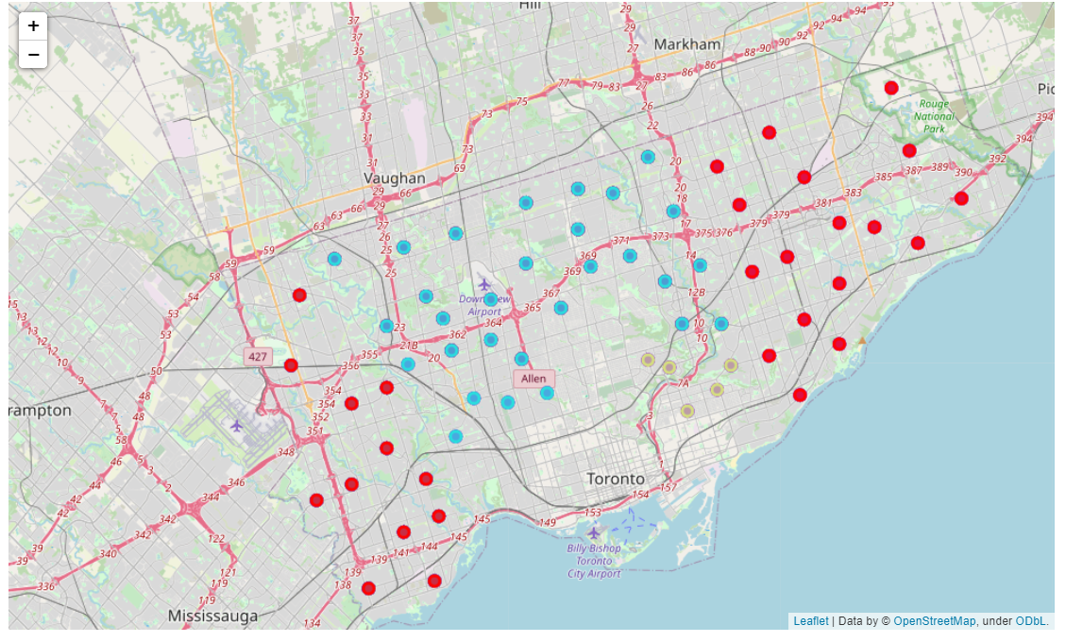
I decided to use the K Means Machine Learning Algorithm to train the data and get the clusters. Once again Folium was used to generate a map of the neighborhoods in Toronto but this time the markers were color coded based on the clusters obtained from the K Means algorithm.

Slide 11
Results and Discussion
In Cluster labeled 1 the case count was below 150 for all neighborhoods and the rate per 100,000 approximately lied between 100-420. Therefore, its label name would be “Least Infected”.
In Cluster labeled 3 the case count was below 300 for all neighborhoods and the rate per 100,000 approximately lied between 450-700. Therefore, its label name would be “Considerably Infected”.
In Cluster labeled 0 the case count was below 400 for all neighborhoods and the rate per 100,000 approximately lied between 700-1200. Therefore, its label name would be “Highly Infected”.
In Cluster labeled 2 the case count was below 500 for all neighborhoods and the rate per 100,000 was above 1200 for all neighborhoods. Therefore, its label name would be “Extremely Infected”.

Slide 12
Conclusion
In this study after carefully analyzing COVID-19 in the city of Toronto from various datasets and using various visualizations and K Means Clustering I clustered neighborhoods based on case count and rate per 100,000.
Currently COVID-19 has a significant impact globally and therefore it is a major factor to take into account when deciding a neighborhood. Therefore, this model is useful to narrow down one’s choice of neighborhood in the city of Toronto.
However, this model only clusters the neighborhoods based on the COVID-19 pandemic and other factors need to be considered when deciding a neighborhood for instance the price, distance from workplace/school, safety etc.
As I mentioned earlier the data is subject to change thus the results of this model are also subject to change.

